Slide 1
ENSE 496AB
Milestone 6
Health-Esteem
December 6th, 2018
Quinn Bast | Jennifer Herasymuik
Shawn Clake | Chengyu Lou
Tristan Heisler | Wilson Nie
Notes:
Shawn

Slide 2
Team Introductions
Team Members:
Jennifer Herasymuik
Shawn Clake
Tristan Heisler
Quinn Bast
Wilson Nie
Chengyu Lou
Team Name:
Health-Esteem
Assigned Project:
Braintrust
Notes:
Shawn

Slide 3
Usability Evaluation
Date: November 22nd, 2018 from 3:30pm to 5:00pm
Location: eHealth Saskatchewan’s Regina office
Data was primarily collected through the use of a questionnaire divided pre-evaluation, evaluation and post-evaluation questions.
This data was compiled into into a Usability Analysis Report which can be found in the documentation folder of our GitHub repository.
This data will also be quickly summarized in the following slides.
Notes:
Tristan

Slide 4
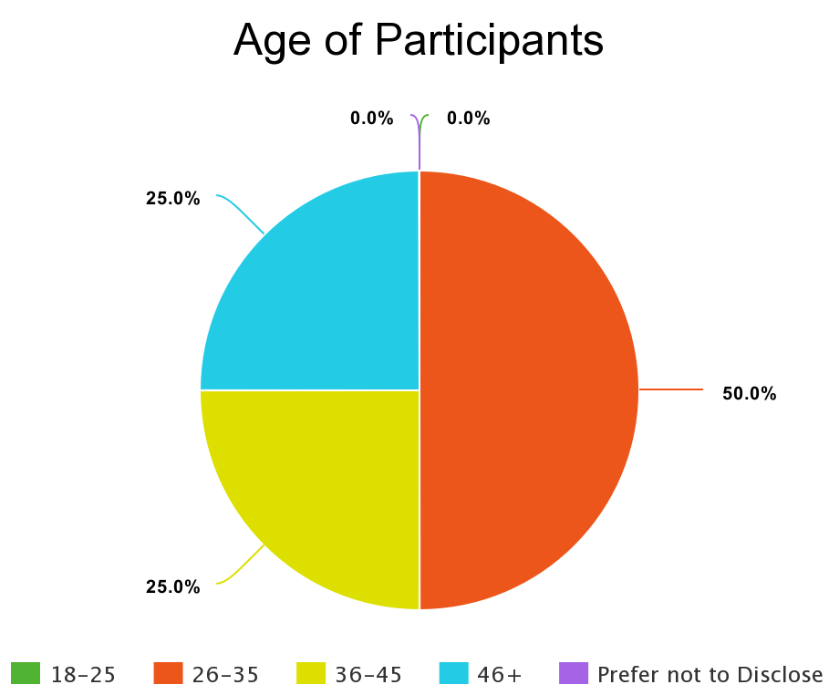
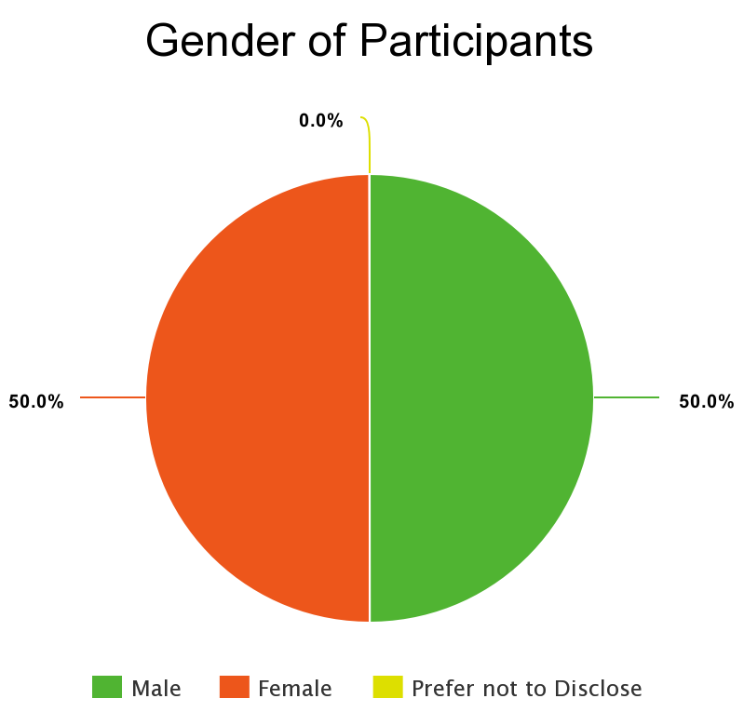
Usability Evaluation - Demographics
Notes:
Tristan

Slide 5
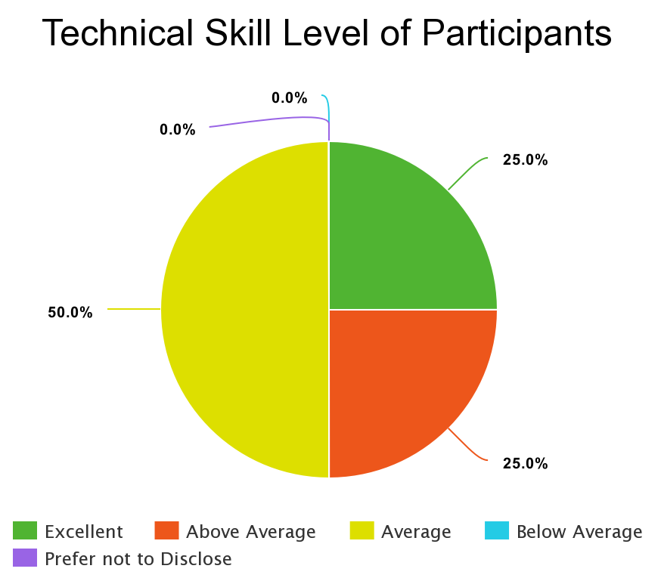
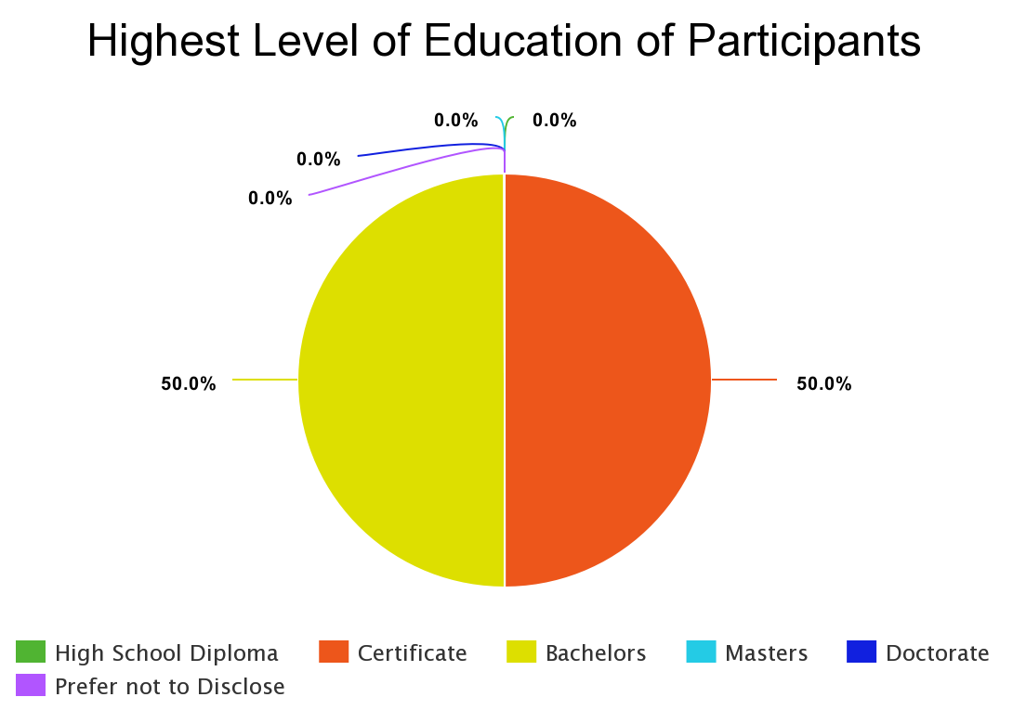
Usability Evaluation - Demographics (cont.)
Additionally, participants came from four different teams within eHealth and have worked for the organization between 2.5 and 6 years.
Notes:
Tristan

Slide 6
Usability Evaluation - Initial Thoughts
Participants were asked for their expectations of the application
Centralized location for submitting and tracking ideas
Focused on supporting the ability to better the organization
Should be user friendly
These goals aligned with our own understanding of the project goals
All users believed they would be a regular user of the application and that it would be beneficial to eHealth
Users were asked about their interest in eHealth merchandise
The intent was to explore a potential reward space
Some participants owned small items such as water bottles and lanyards
The general consensus was only a slight interest
Notes:
Tristan

Slide 7
Usability Evaluation - Tasks
Account Registration and Login
Two major issues were identified.
If a weak password was entered, the available divisions and units vanished.
If no internet connection was present, the registration timed out.
Both of these issues have since been fixed.
Homepage
No issues existed with finding the homepage.
Suggestions were made for a customizable dashboard.
Notes:
Tristan

Slide 8
Usability Evaluation - Tasks (cont.)
Idea Creation
No issues were identified with creating a draft or submitting an idea.
However, it was noted that several participants were looking to create an idea from the navigation bar. This functionality has been added.
Idea Interaction
When asked to view more details about an idea, several users clicked the title of the idea. Support for this feature has been added.
No issues were identified for tracking or rating an idea
No issues were identified for leaving an amendment on an idea. However, they have been renamed to comments based on user feedback.
Minor issues arose when attempting to filter ideas.
Notes:
Tristan

Slide 9
Usability Evaluation - Tasks (cont.)
Idea Progression
No major issues arose when progressing the status of an idea.
No issues were identified when abandoning an idea.
Statistics and Leaderboards
No issues were identified for viewing team statistics.
No issues were identified for viewing the individual leaderboard.
Profile Page
No issues arose when attempting to find the profile page.
A minor caching issue arose while updating profile pictures.
FAQ Page
Participants suggested the ability for users to submit questions.
Notes:
Tristan

Slide 10
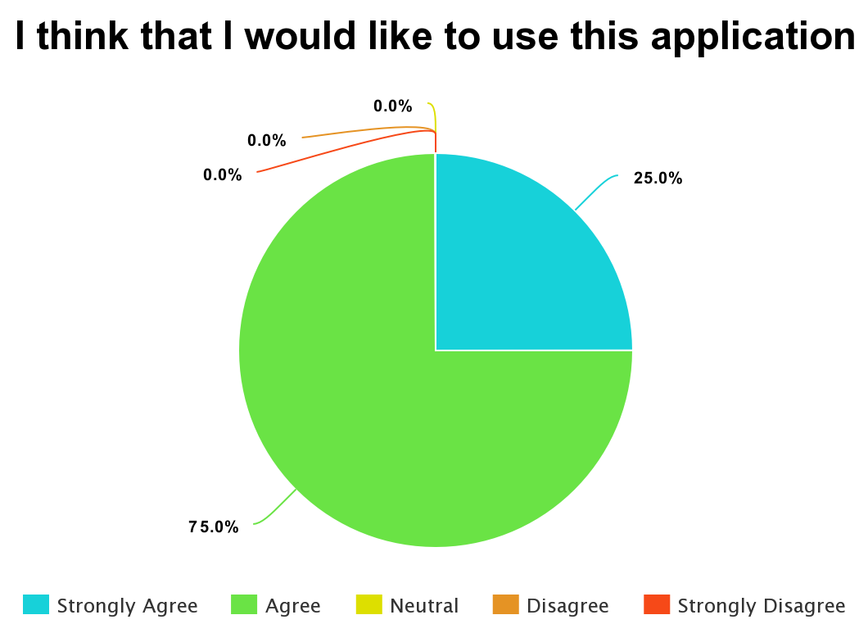
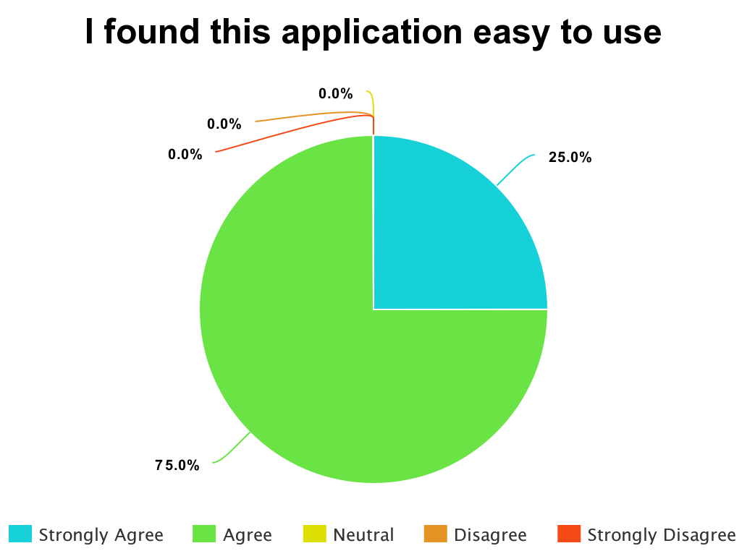
Usability Evaluation - Rating
Notes:
Tristan

Slide 11
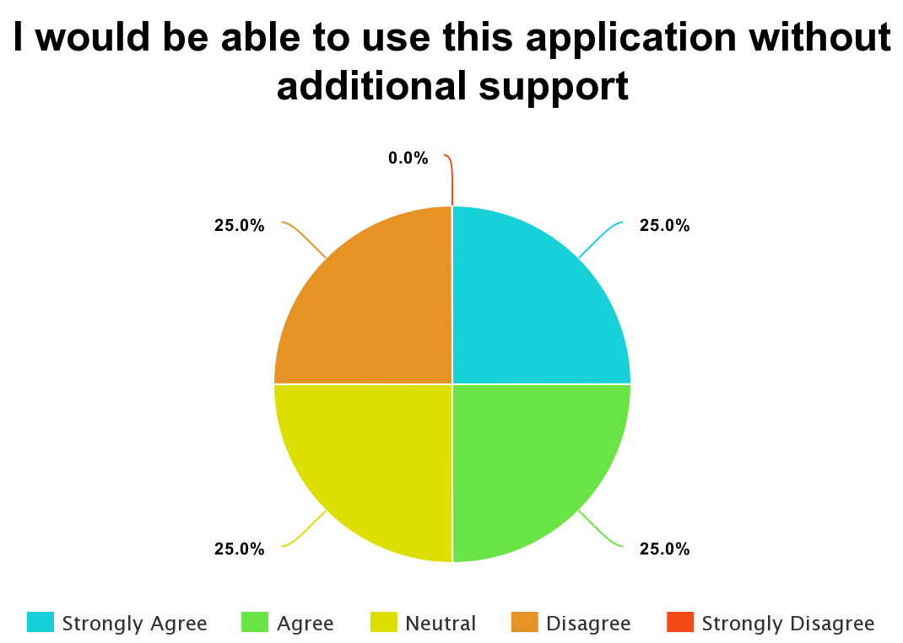
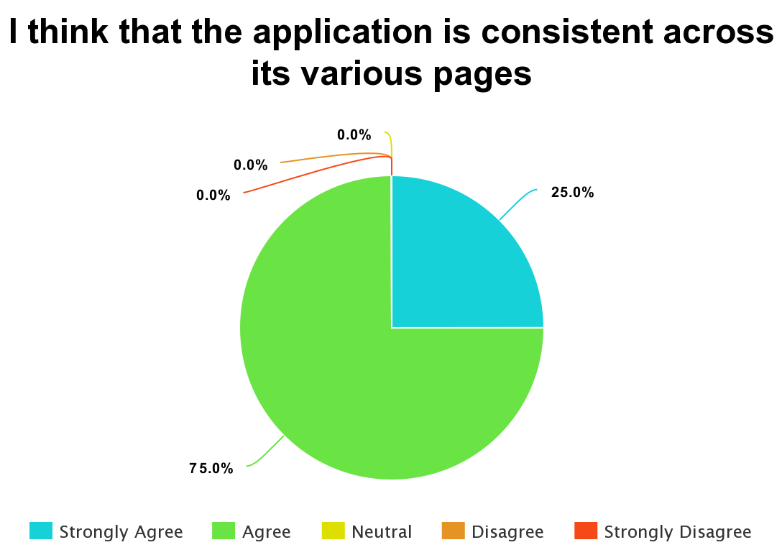
Usability Evaluation - Rating (cont.)
The desire for additional support reinforces the importance of the user manual.
Notes:
Tristan

Slide 12
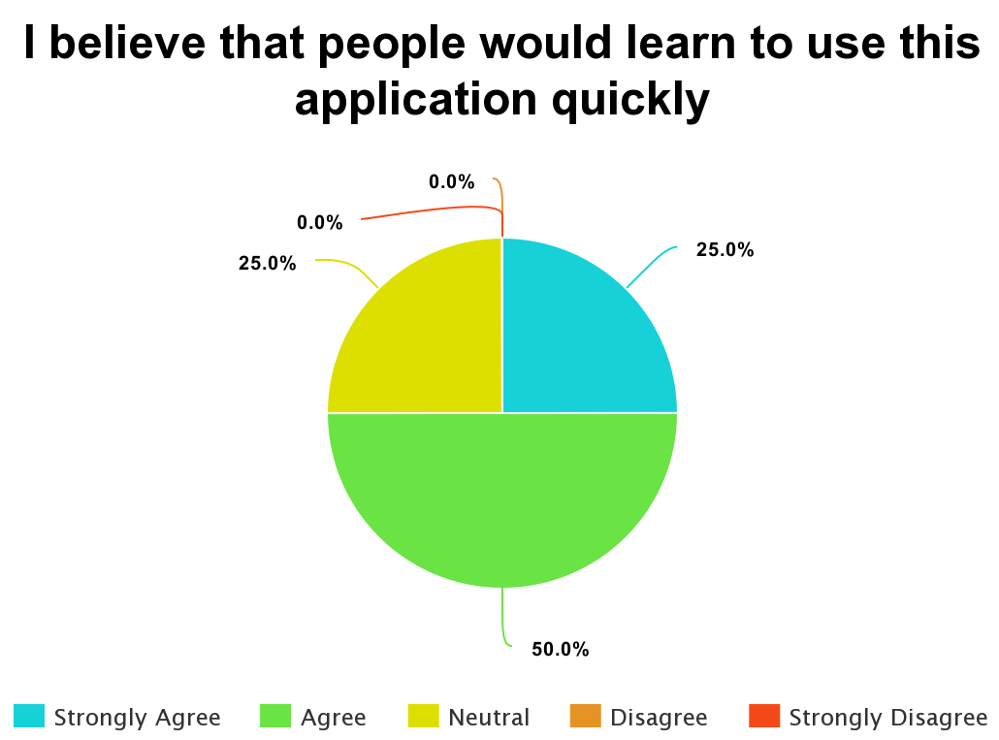
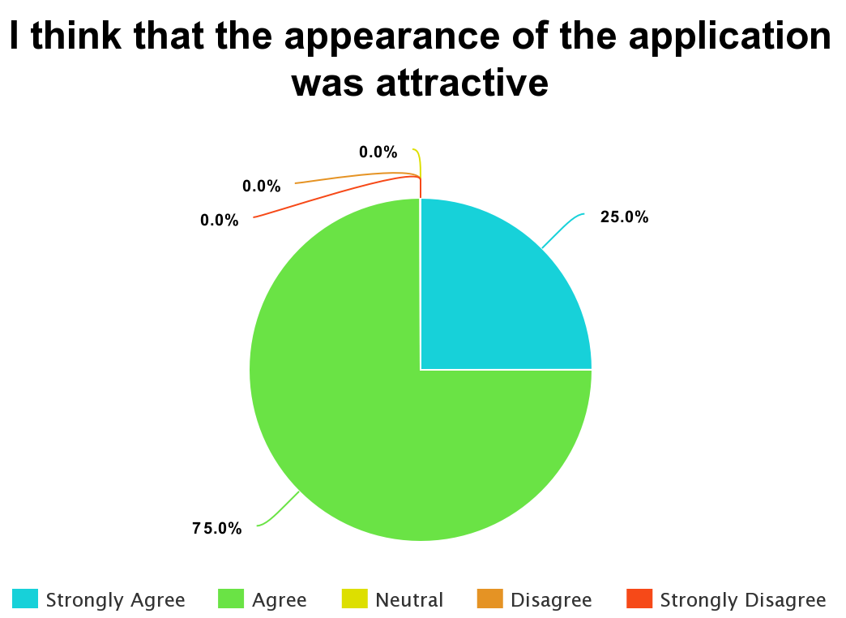
Usability Evaluation - Rating (cont.)
Notes:
Tristan

Slide 13
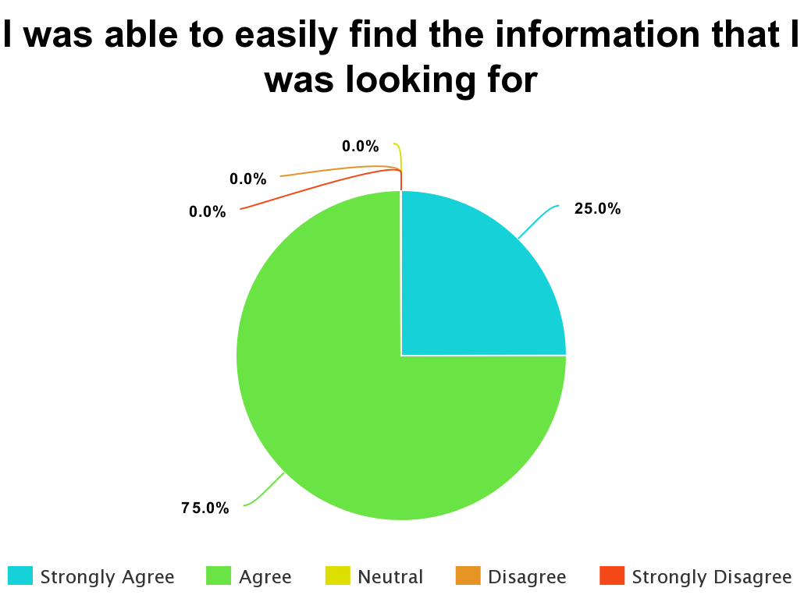
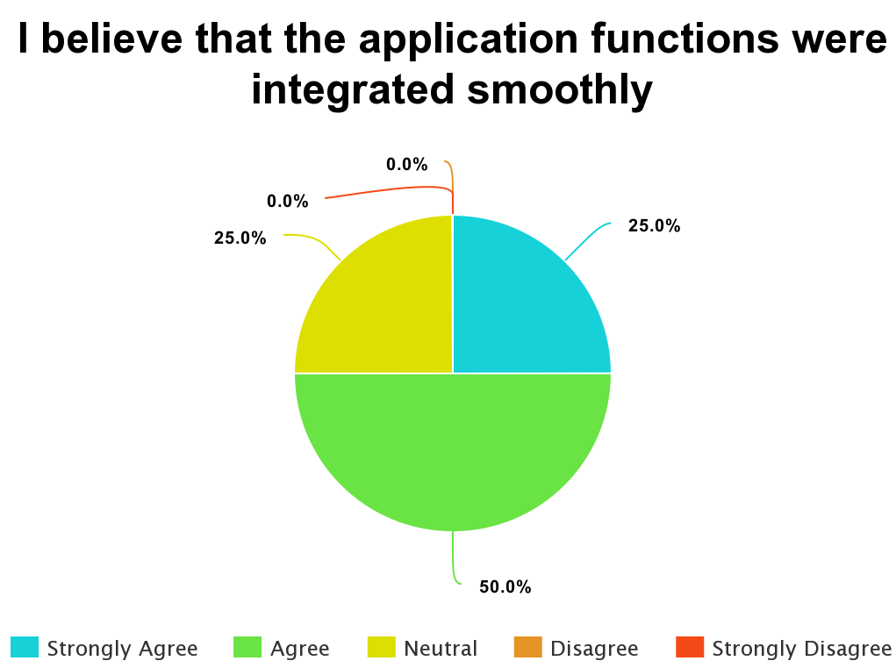
Usability Evaluation - Rating (cont.)
Notes:
Tristan

Slide 14
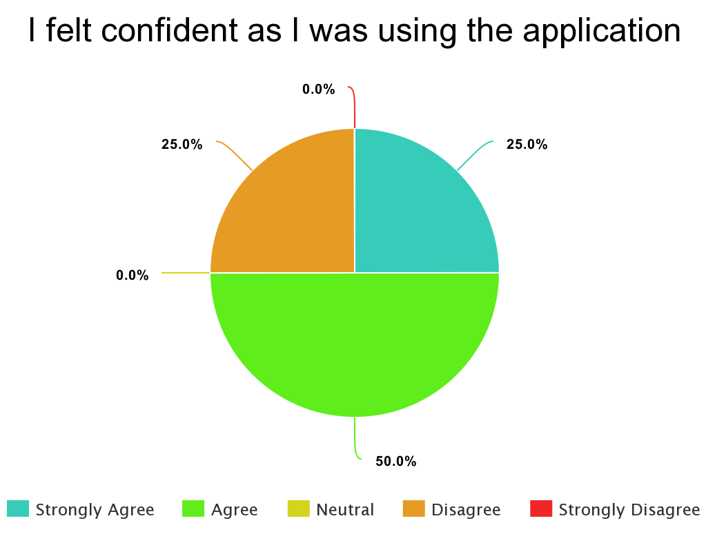
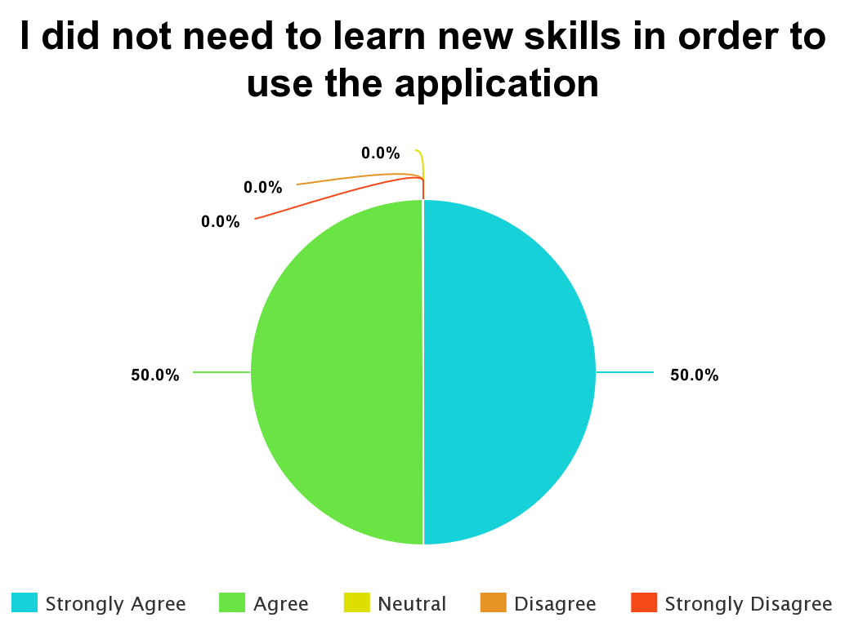
Usability Evaluation - Rating (cont.)
Notes:
Tristan

Slide 15
Usability Evaluation - Parting Thoughts
Responses to these questions were brief due to time constraints
Participants believed the application was user-friendly
A suggestion was made to incorporate more documentation during the progression of an idea.
Participants agreed that gamification could be beneficial
However, a rewards system was determined to be low priority
This led to the deprioritization of this feature
Notes:
Tristan

Slide 16
USM Review and Rationalization
Envisioned Features
Idea filtering, graphs, contact us, success stories and new information.
Changes in the USM
The USM was modified to remove features that were not critical for the final deliverable of the application and instead focus primarily on quality of life improvements.
Rationalization
This release provides users with additional functionality such as searching for specific ideas and updating the homepage information. More importantly, this release contains many bug fixes and improvements as identified during the usability analysis process.
Notes:
Wilson

Slide 17
Timeline
Usability Analysis at eHealth
Distributed MVP 4 Tasks
Group Programming and Documentation Session
Practiced Presentation
Nov 27
Nov 29
Dec 5
Nov 22
Nov 27
Nov 30
Dec 6
Reworked Final Milestone Deliverables
Group Programming Session
Made PowerPoint
Notes:
Wilson

Slide 18
Contributions
Team Member Main Priorities
Jenn - Unit testing, ability to update success stories and what’s new
Oscar - Create idea modal, contact us page
Quinn - User manual, idea filtering by title and author
Shawn - Ideas page overhaul, FAQ improvements, profile page improvements
Tristan - Usability analysis compilation, navigation bar improvements, idea improvements
Wilson - Resolved registration-related bugs, ideas page overhaul
There was overlap of these responsibilities among other group members.
ie. All group members were responsible for identifying and resolving bugs within the
application as identified within our GitHub issues.
Notes:
Wilson

Slide 19
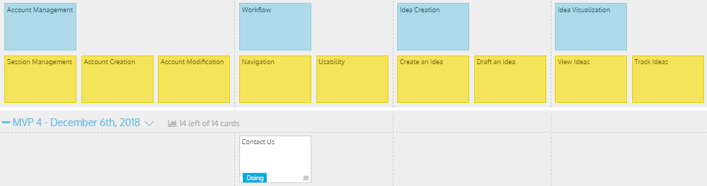
MVP 4/Milestone 6 USM - Original
Notes:
Quinn

Slide 20
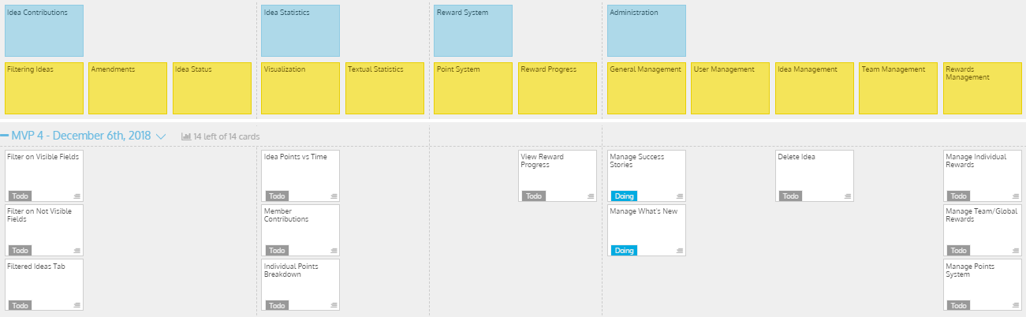
MVP 4/Milestone 6 USM - Original (cont.)
Notes:
Quinn

Slide 21
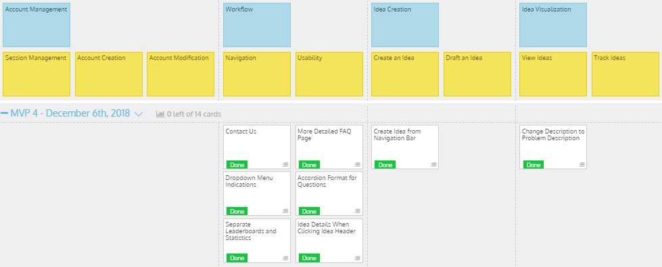
MVP 4/Milestone 6 USM - Modified (cont.)
Notes:
Quinn

Slide 22
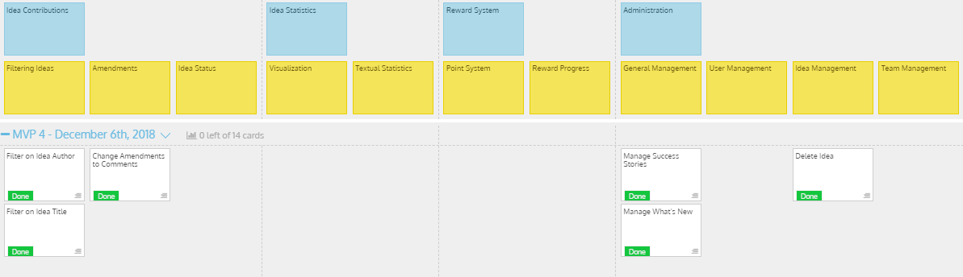
MVP 4/Milestone 6 USM - Modified (cont.)
Notes:
Quinn

Slide 23
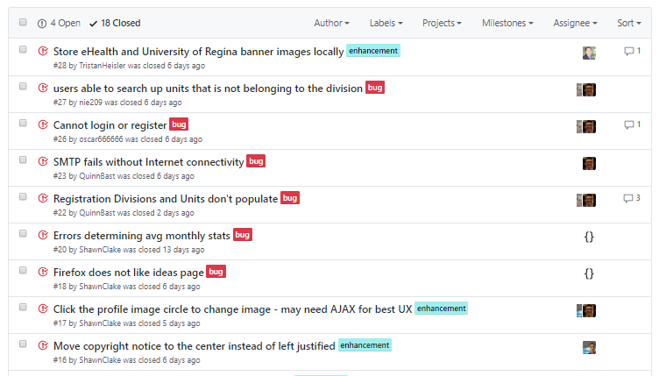
GitHub Issues - Bug Tracking and Resolution
Notes:
Wilson

Slide 24
Milestone 6
Demo
Health-Esteem
Notes:
Tristan

Slide 25
Project Documentation & Testing
Feature Pros and Cons Excel
Initial excel sheet to discuss Braintrust’s initial functionality.
Discussion with Janice
Document of questions and answers from Janice.
Milestone TO-DO Lists
Rough word doc outlining responsibilities for each milestone.
Unit testing
Used unit tests to ensure the application functions as expected.
Usability Analysis Report
Summarizes responses obtained from usability testing at eHEALTH.
User manual
A document aimed to help users understand and use the application.
Notes:
Quinn - also open the user manual and walk through it quickly

Slide 26
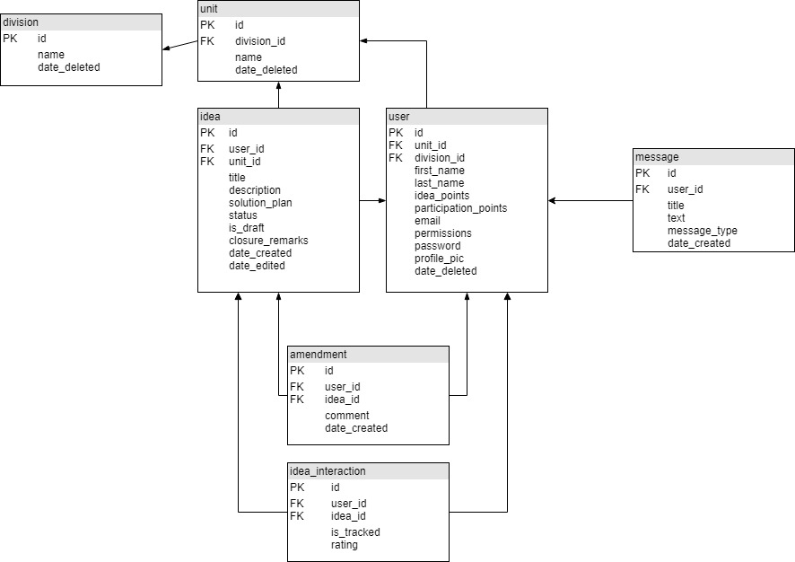
Database Design - Final UML
Notes:
Jenn

Slide 27
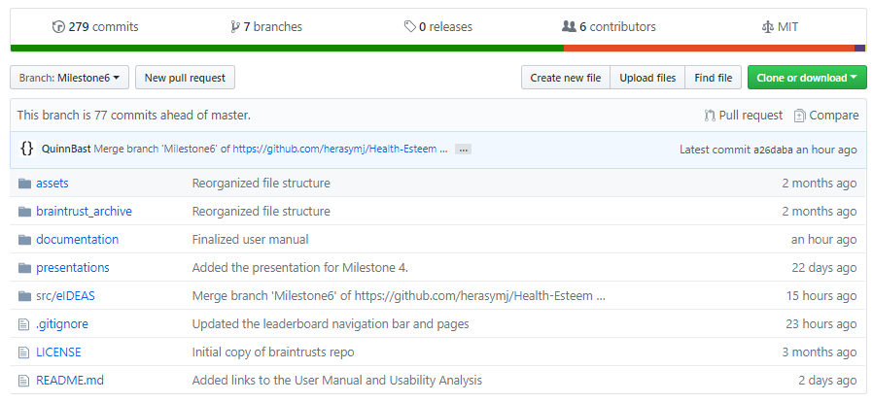
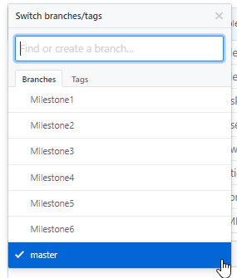
Revision Control - GitHub
https://github.com/herasymj/Health-Esteem/tree/master
Notes:
Jenn

Slide 28
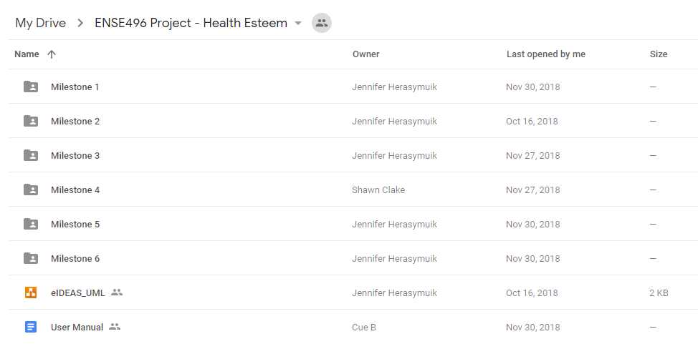
Other Tools - Google Drive
https://drive.google.com/drive/folders/1xXZoQ2bTMq2rhHzLl4sXl5ZG7T7oY1FZ
Notes:
Jenn

Slide 29
Next Steps & Recommendations
Consider additional features based on usability analysis feedback
Export statistics as a pdf
Customizable dashboard
Larger and more detailed FAQ page
Newsfeed
Explore features that were delayed
Rewards system
Graphing and other visualization tools
Enhancements
Always aim to improve the usability of the application based on user feedback
Bug fixes
Mostly within the .net auth component and email system
A few issues are still identified within our GitHub issues page
Notes:
Oscar

Slide 30
Discussion
Success
Completed all features within the current sprint.
Completed majority of initially planned features.
Implemented significant improvements based on usability evaluation.
No (known) major application-breaking bugs (anymore).
Barriers
Uncertainty on requirements led to the delay of certain features.
Priority on reporting and graphing was unknown until user evaluation. The desire for this functionality was much higher than we initially expected.
Other planned features, such as a rewards system, were revealed to have lower priority by the organization.
Notes:
Shawn

Slide 31
Group Reflection
How do you feel about this project? What do you like about it? What did you dislike?
Like: Reacting to user feedback was an interesting learning experience.
Dislike: User feedback tended to be superficial and user expectations were higher than what should have been realistic. Ie. Customizable Dashboard
What did you learn about yourself as you collaborated and worked through this project?
We each have strong opinions on what the last deliverable should have looked like and also about how we approach user feedback.
Notes:
Shawn

Slide 32
Group Reflection (cont.)
How will you use what you have learned going forward?
A more democratic process should be implemented when discussing deliverables, features, and priorities in the absence of a ‘client’.
What “stuff & things” related to this project would you want help with?
More time with user testing. Impossible to gauge the severity/existence of an issue with only two tests.
Our choice of code license. Ie. GPL 3 or Apache.
Anyone can remove recognition.
Improvements are useless to other organizations/individuals as changes are not required to be shared back; including bug fixes.
This contradicts the idea of open and collaborative work.
Notes:
Shawn

Slide 33
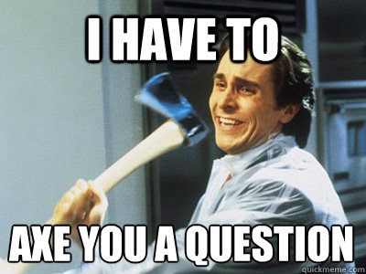
Questions?
Notes:
Shawn

